Slide 1
Practical Machine Learning

Slide 2
It’s Badger Time!

Slide 3
Situation:
While the entire REP cohort was too busy studying for finals last year, a secret army of mutated badgers escaped from the zoo and infested North Hill! In order to stop them, REPO has enlisted your help in deploying smart cameras in the area to track their movements.
Task:
Develop an algorithm that can help identify and classify these mutated badgers.

Slide 4
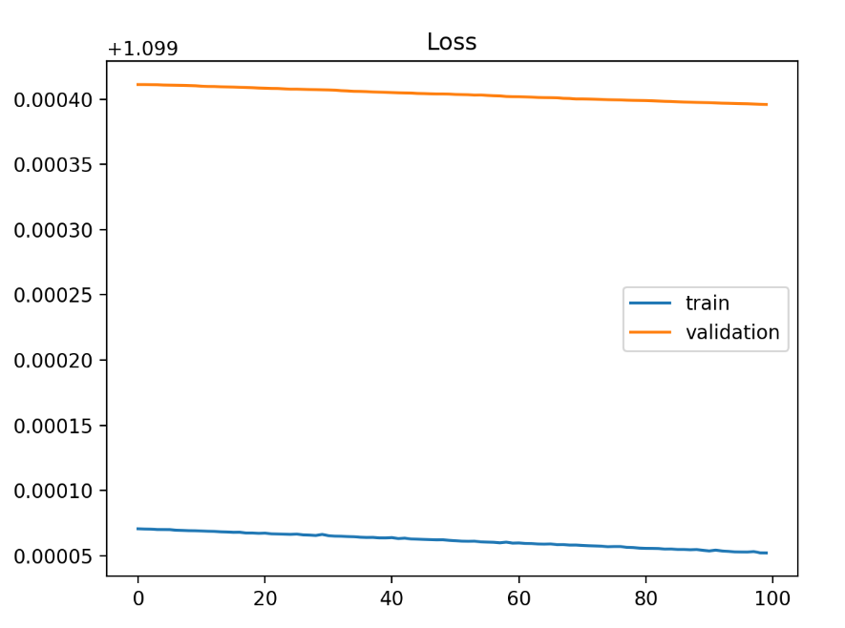
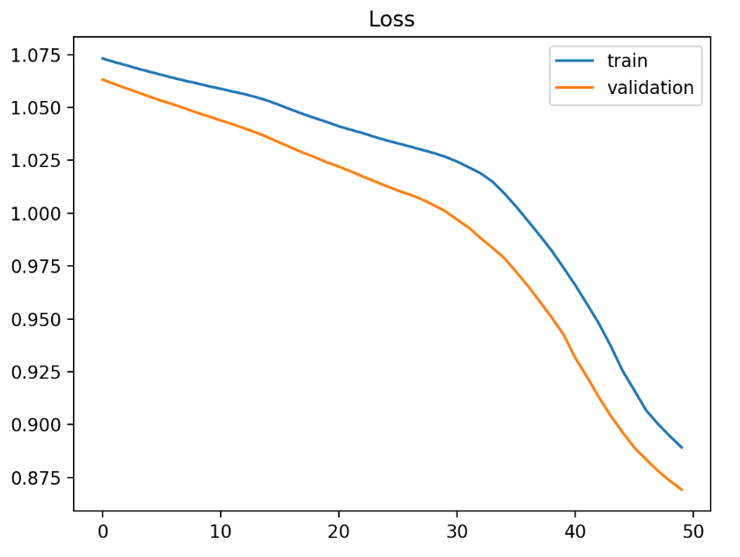
Underfit - cannot learn the training data at all

Slide 5
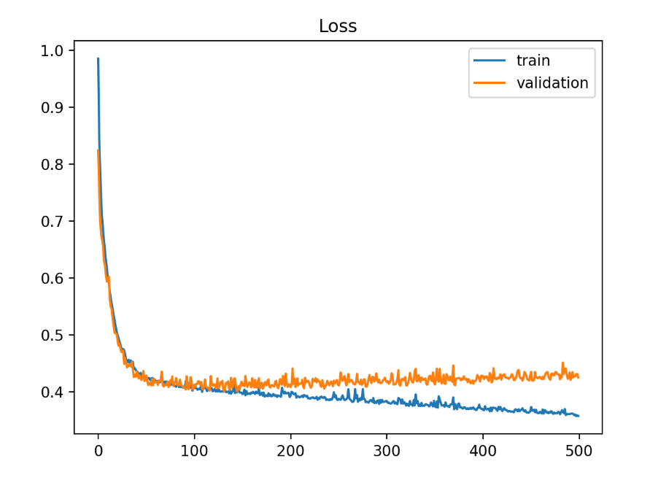
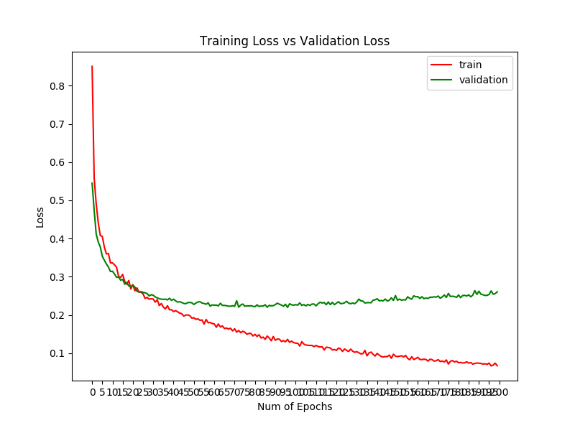
Overfit - learns training data too well

Slide 6
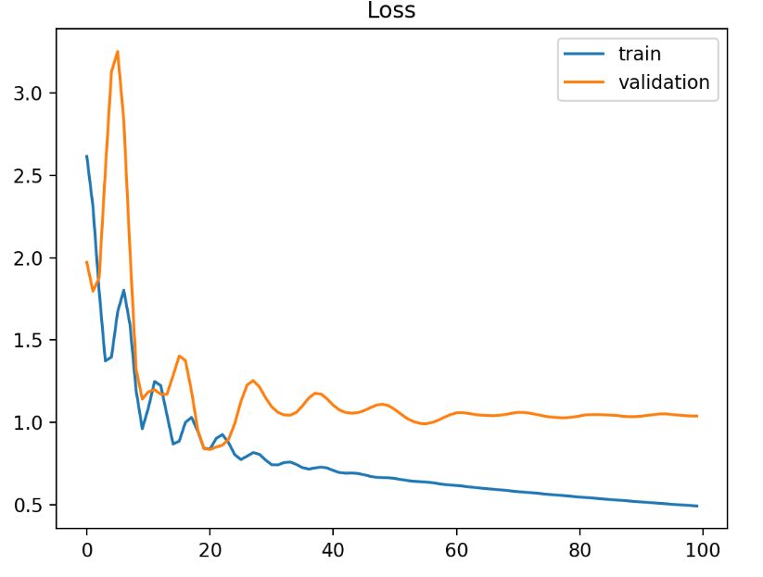
Unrepresentative training sets

Slide 7
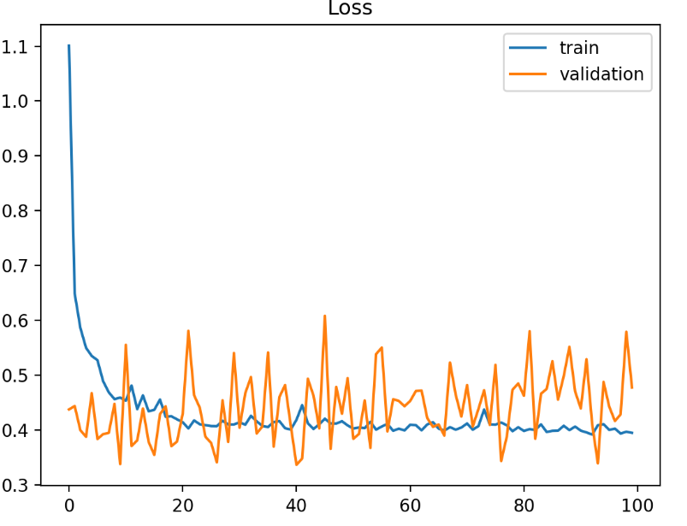
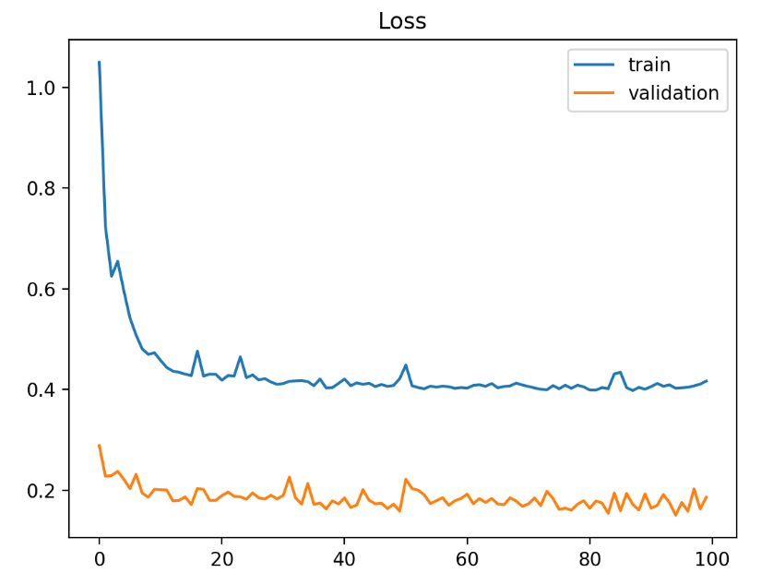
Unrepresentative validation sets

Slide 8
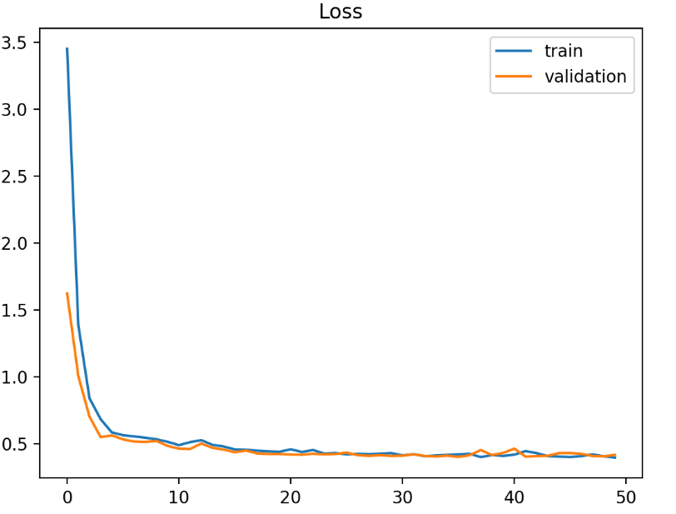
Good fit

Slide 9
How to optimize?
Grid Search Cross Validation
Random Search
Automated Hyperparameter tuning
Notes:
https://towardsdatascience.com/hyperparameters-optimization-526348bb8e2d

